Slide 1
RotaJakiro ADS Report
Aidan Border

Slide 2
Goal Categorization
Detect attempts to install the RotaJakiro backdoor on Linux hosts by looking for a droppped systemd services.
These attempts are categorized under Persistence / Create or Modify System Process / Systemd service

Slide 3
Strategy Abstract
Strategies for defending against this threat should go as follows:
Use endpoint monitoring and protection tooling to monitor services or processes running on a Linux host.
Look for specific service names or processes known to be used by RotaJakiro
sys-temd-agent.service
gvfsd-helper
systemd-daemon
Fire an alert if any of these processes are found on the system.

Slide 4
Technical Context
Most modern Linux systems use a project called systemd as their init system and services manager. systemd services are background programs that run to support different functionality. An example of a program that runs as a service is sshd, the OpenSSH Server daemon.
There are two directories that systemd will look for services in.
System-wide services are located in /etc/systemd/system/services.
Services that run when a user logs in are located in ~/.config/systemd/user.
A systemd service can technically be used to automatically launch any software on the system. Threat actors can use this to auto-launch malicious software, such as starting a keylogger when a privileged user logs in to attempt to siphon administrator credentials to the system.
Notes:
It is important to note that a keylogger targeting X.Org is very easy to write. Installing a user-level service to log every keystroke to a file would be relatively easy given a way to run a shell script.

Slide 5
Blind Spots and Assumptions
We assume the system uses systemd. Linux systems using other methods of init are not applicable for the ADS discussed here.
We assume RotaJakiro is running as root. If the backdoor is running as a normal user, it makes use of XDG Autostart (under a graphical environment) or .bashrc for users running without a desktop environment.
Unix systems, such as FreeBSD, do not use systemd. As such, the strategy discussed here is not applicable to those systems.

Slide 6
False Positives
This alert may cause false positives for systems running the GNOME Desktop Environment if the backdoor is running without root privileges, as the backdoor masquerades as gvfsd, or the GNOME Virtual File System daemon.

Slide 7
Validation
Validation can be performed by executing the provided shell script to generate a systemd service in the /etc/systemd/system directory.
The detection should alert on the generated systemd service, since it uses the same name as the backdoor.

Slide 8
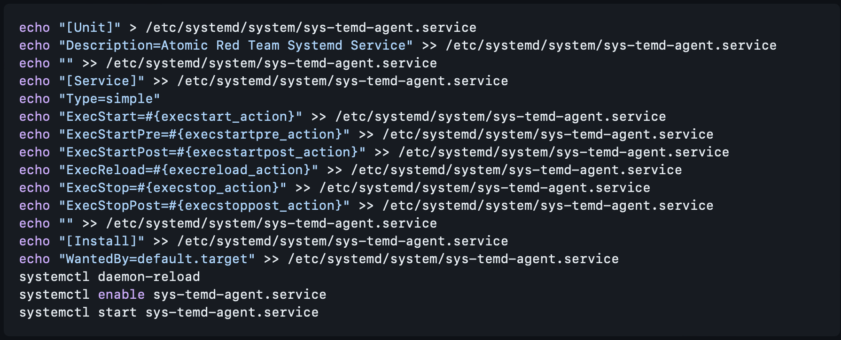

Slide 9
Priority
Since this is a backdoor with a variety of features, any true positive alerts fired from this detection are set to high.

Slide 10
Response
The following steps should be taken immediately upon a true positive alert:
Remove the system from the network
Disable the systemd service using `systemctl` to prevent it from running at boot, then stop the service. Alternatively, the system can simply be restarted.
Depending on the security requirements of your environment, you may consider deleting the service file from the filesystem.
Kill the systemd-daemon binary if it is actively running.
Again, depending on your environment, the binary can be removed now as well
Escalate to a security incident after the immediate threat has been removed.

Slide 11
References
[^1]: Shell script originally published by [Atomic Red Team](https://atomicredteam.io/privilege-escalation/T1543.002/#atomic-test-1---create-systemd-service). I removed the templates and added the path to the systemd service location and name of the systemd service.
[^2]: [Arch boot process - Arch Wiki](https://wiki.archlinux.org/title/Arch_boot_process)
[^3]: [MITRE ATT&CK - Create or Modify System Process: Systemd Service](https://attack.mitre.org/techniques/T1543/002/)
[^4]: [RotaJakiro: A long live secret backdoor with 0 VT detection](https://blog.netlab.360.com/stealth_rotajakiro_backdoor_en/)
[^5]: [Backdoor.Linux.ROTAJAKIRO.A](https://www.trendmicro.com/vinfo/us/threat-encyclopedia/malware/backdoor.linux.rotajakiro.a/)

